Slide 1
Opening Five Italian Restaurants in Paris
The Battle of the neighborghoods

Slide 2
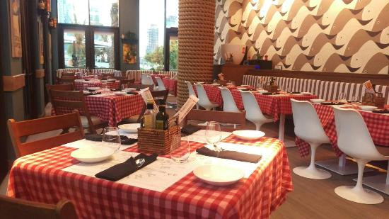
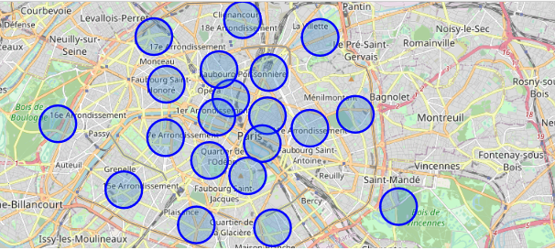
Introduction
Review Paris for a company
Best Location for opening five new Italian restaurants
Business Problem:
Choose the five most suitable neighborhoods (arrondissements) for opening new restaurants in Paris.
Arrondissement with Few other Italian restaurants.
Arrondissement with no successful Italian Restaurants.
Succes Criteria :
Five arrondissements wich meet the above criterias

Slide 3
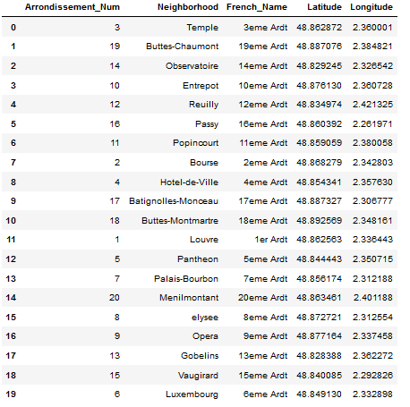
Data aquisition and cleaning
Paris is divided into 20 districts (or administrative districts), shortened to just “arrondissements”. They are referenced by the arrondissement number rather than a name.
Data for the arrondissements was selected from Open|DATA France: https://opendata.paris.fr/explore/dataset/arrondissements/table/?dataChart
Data for the arrondissements of paris was selected, reorganized in a dataframe and cleaned.

Slide 4
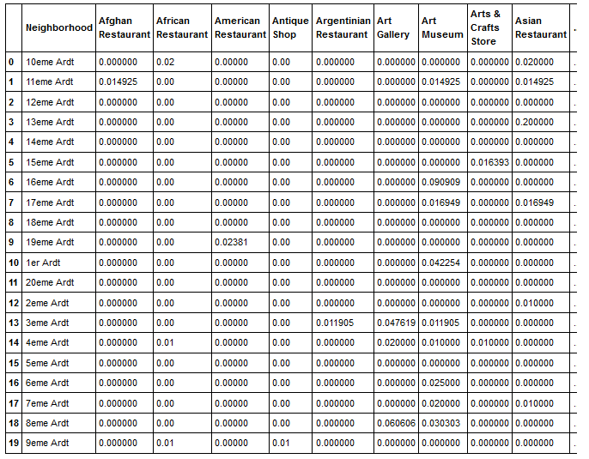
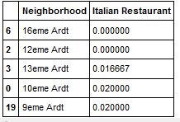
Foursquare API venues explore : Geting the venues of given neighborhoods
- Classified neighborhoods by using venues distribution and counts.
Arrondissements having the lowest frequency mean of Italian Restaurants

Slide 5
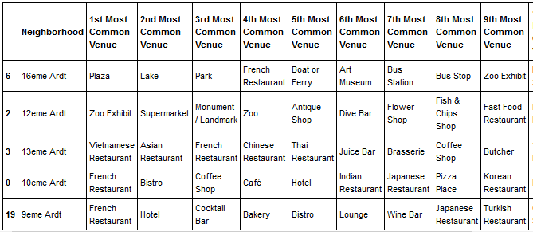
Foursquare API venues method: checking competition in the selected arrondissements
No Italian restaurant among the ten most common venues in the selected arrondissements.

Slide 6
Discussion and Conclusions:
The boroughs selected at the end of this study are as follows:
-9eme arrondissement
-10eme arrondissement
-12eme arrondissement
-13eme arrondissement
-16eme arrondissement
This is a preliminary study which allowed us to select the districts of Paris where there is room for another Italian restaurant. It is one approach among many. In fact, there are several factors that can condition the success of these establishments, such as the purchasing power of the inhabitants or the attendance rate of these districts.

